Slide 1
Chapter 12: Interrupts (岔斷)

Slide 2
12–1 BASIC INTERRUPT PROCESSING
This section discusses the function of an interrupt in a microprocessor-based system.
Structure and features of interrupts available
to Intel microprocessors.

Slide 3
The Purpose of Interrupts
Interrupts are useful when interfacing I/O devices at relatively low data transfer rates, such as keyboard inputs, as discussed in Chapter 11.
Interrupt processing allows the processor to execute other software while the keyboard operator is thinking about what to type next.
When a key is pressed, the keyboard encoder debounces the switch and puts out one pulse that interrupts the microprocessor.

Slide 4
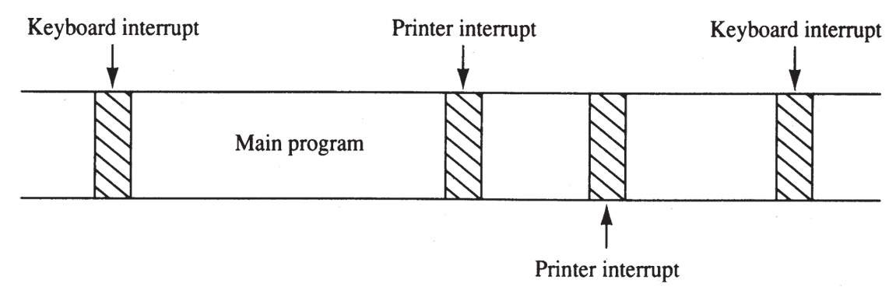
Figure 12–1 A time line that indicates interrupt usage in a typical system.
  a time line shows typing on a keyboard,
  a printer removing data from memory, and a program executing
  the keyboard interrupt service procedure, called by the keyboard interrupt, and the printer interrupt service procedure each take little time to execute

Slide 5
Interrupts
Intel processors include two hardware pins (INTR and NMI) that request interrupts…
And one hardware pin (INTA) to acknowledge the interrupt requested through INTR.
The processor also has software interrupts INT, INTO, INT 3, and BOUND.
Flag bits IF (interrupt flag) and TF (trap flag), are also used with the interrupt structure and special return instruction IRET
  IRETD in the 80386, 80486, or Pentium

Slide 6
Interrupt Vectors
Interrupt vectors and the vector table are crucial to an understanding of hardware
and software interrupts.
The interrupt vector table is located in
the first 1024 bytes of memory at addresses 000000H–0003FFH.
  contains 256 different four-byte interrupt vectors
An interrupt vector contains the address (segment and offset) of the interrupt service procedure.

Slide 7
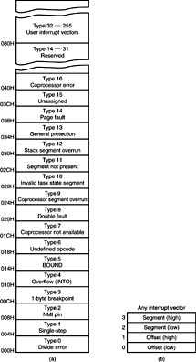
Figure 12–2 (a) The interrupt vector table for the microprocessor and (b) the contents of an interrupt vector.
  the first five interrupt vectors are identical
  in all Intel processors
  Intel reserves the first 32 interrupt vectors
  the last 224 vectors are user-available
  each is four bytes long and contains the starting address of the interrupt service procedure.
  the first two bytes contain the offset address
  the last two contain the segment address

Slide 8
Intel Dedicated Interrupts
Type 0
The divide error whenever the result from a division overflows or an attempt is made to divide by zero.
Type 1
Single-step or trap occurs after execution of each instruction if the trap (TF) flag bit is set.
  upon accepting this interrupt, TF bit is cleared
  so the interrupt service procedure executes at
  full speed

Slide 9
Type 2
The non-maskable interrupt occurs when a logic 1 is placed on the NMI input pin to the microprocessor.
  non-maskable—it cannot be disabled
Type 3
A special one-byte instruction (INT 3) that uses this vector to access its interrupt-service procedure.
  often used to store a breakpoint in a program
  for debugging

Slide 10
Type 4
Overflow is a special vector used with the INTO instruction. The INTO instruction interrupts the program if an overflow
condition exists.
  as reflected by the overflow flag (OF)

Slide 11
Type 5
The BOUND instruction compares a register with boundaries stored in the memory.
If the contents of the register are greater than or equal to the first word in memory and less than or equal to the second word, no interrupt occurs because the contents of the register are within bounds.
  if the contents of the register are out of bounds,
  a type 5 interrupt ensues

Slide 12
Interrupt Instructions: BOUND, INTO, INT, INT 3, and IRET
Five software interrupt instructions are available to the microprocessor:
INT and INT 3 are very similar.
BOUND and INTO are conditional.
IRET is a special interrupt return instruction.

Slide 13
BOUND : Check array against boundary
INTO: Interrupt on overflow
INT: Interrupt
INT 3: Interrupt 3
IRET: Return from interrupt

Slide 14
BOUND has two operands, and compares a register with two words of memory data.
INTO checks or tests the overflow flag (O).
  If O = 1, INTO calls the procedure whose
  address is stored in interrupt vector type 4
  If O = 0, INTO performs no operation and the
  next sequential program instruction executes
The INT n instruction calls the interrupt service procedure at the address
represented in vector number n.

Slide 15
INT 3 instruction is often used as a breakpoint-interrupt because it is easy to insert a one-byte instruction into a program.
  breakpoints are often used to debug software
The IRET instruction is a special return instruction used to return for both software and hardware interrupts.
  much like a far RET, it retrieves the return address from the stack

Slide 16
Daisy-Chained Interrupt
This way of deciding the interrupt priority consists of serial connection of all the devices which generates an interrupt signal. The device with the highest priority is placed at the first position followed by lower priority devices and the device which has lowest priority among all is placed at the last in the chain.

Slide 17
Daisy-Chained Interrupt
In daisy chaining system all the devices are connected in a serial form. The interrupt line request is common to all devices. If any device has interrupt signal in low level state then interrupt line goes to low level state and enables the interrupt input in the CPU.

Slide 18
Daisy-Chained Interrupt
When there is no interrupt the interrupt line stays in high level state. The CPU respond to the interrupt by enabling the interrupt acknowledge line. This signal is received by the device 1 at its PI input. The acknowledge signal passes to next device through PO output only if device 1 is not requesting an interrupt.

Slide 19
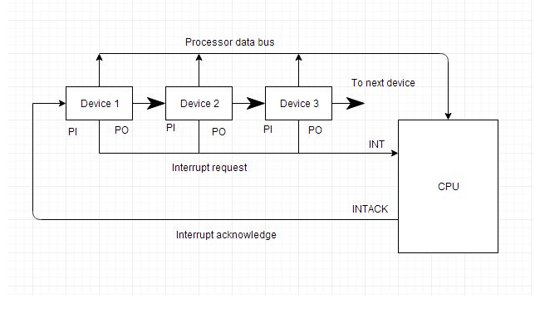
Daisy-Chained Interrupt

